Slide 1


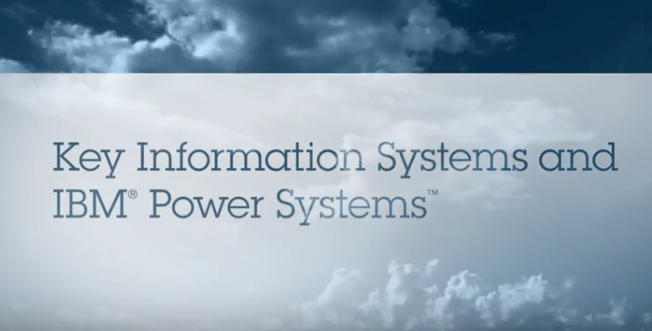

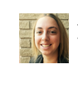



IBM Power Systems
Quickly and easily deploy cloud services
Businesses are increasingly turning to managed service providers to lower the cost and complexity of infrastructure, provide new services and manage changing resource demands. MSPs can now leverage the advantages of delivering cloud services on Power Systems
A cloud that exceeds expectations
Take a minute to watch how this cloud provider offers customized cloud infrastructures that go above and beyond typical performance, giving one client a 48x improvement in runtimes in this short video.
Contact IBM
Learn more
IBM Power Systems Solution Edition for Cloud is a pre-built, customizable system.
Analysts agree
In this analyst report, the Robert Frances Group agree Power Systems servers are more powerful and less costly than competing solutions from x86 providers.
Have questions?
Speak to Becky, our MSP Specialists to discuss your cloud infrastructure needs?
Mention code: C#######
Dowload the solution brief
Read the report
Talk to an expert
Notes:
URL’s:
Video / Ungated: http:////fdjksljsklj
Solution Brief / Ungated: http:/jfdkjksjk
Robert Frances Group Report / Gated: http:/fjdkfljdksj

